Slide 1
Building Custom Connector for Power Automate
Satish Reddy

Slide 2
Building a Custom Connector for Power Automate
Satish Reddy

Slide 3
About me
Founder, Architect and Trainer
12 years exp in Microsoft Dynamics
Pascalcase Software Private Ltd
Ex-Microsoft Employee
Admin of Dynamics 365 Meetup Group - Hyderabad
Developed Chromium Metadata Browser Tool

Slide 4
Session Agenda
Introduction to Connectors
Building Custom Connectors with an example
Develop Connector using Postman Collection
Import into Power Automate
Test the Connector
Publishing the Connector
Opportunities for ISV Solutions

Slide 5
Introduction to Connectors

Slide 6
Building the Connector

Slide 7
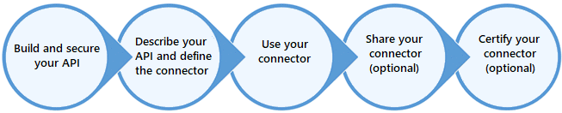
Lifecycle

Slide 8
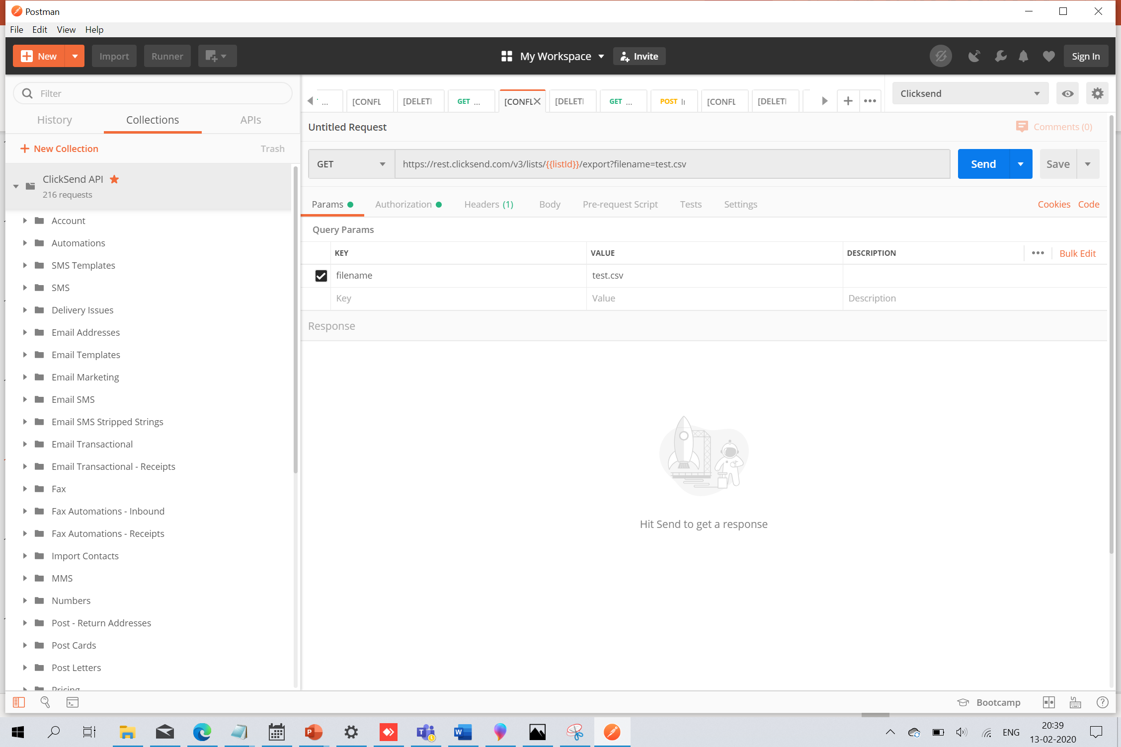
Working with Postman

Slide 9
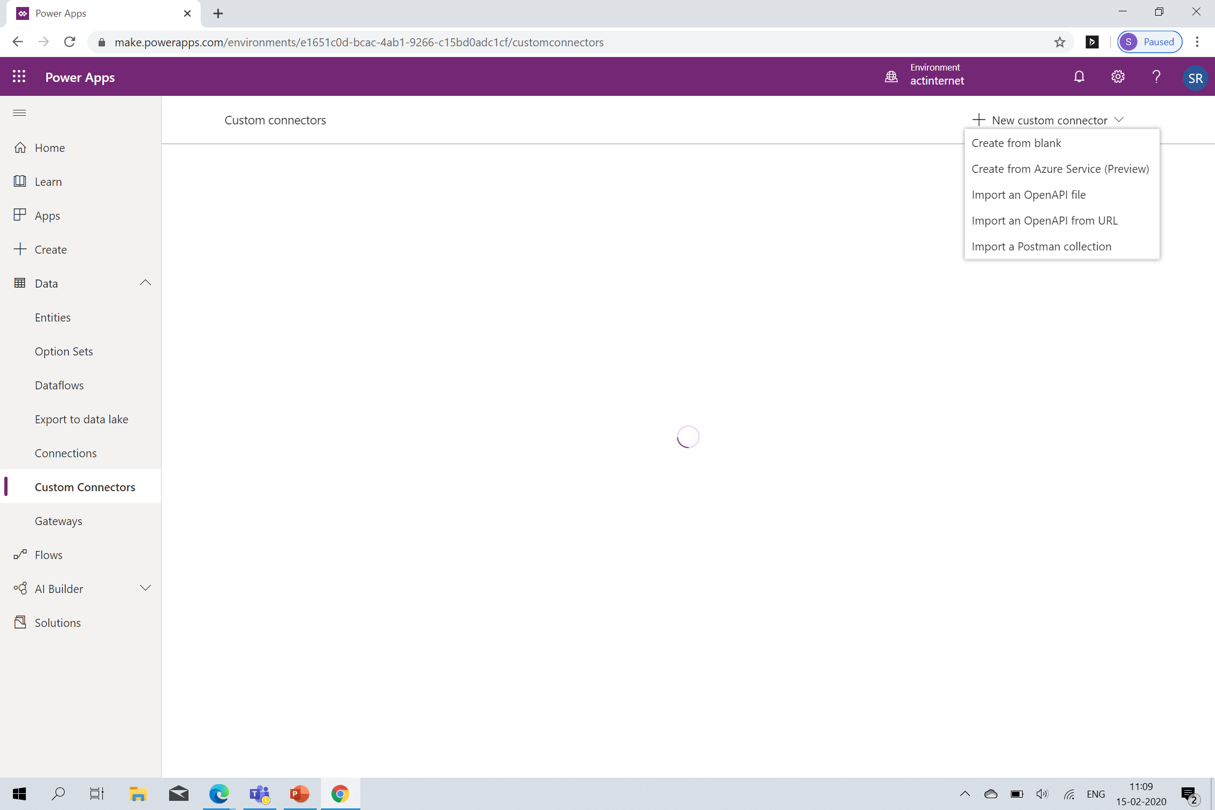
Demo

Slide 10
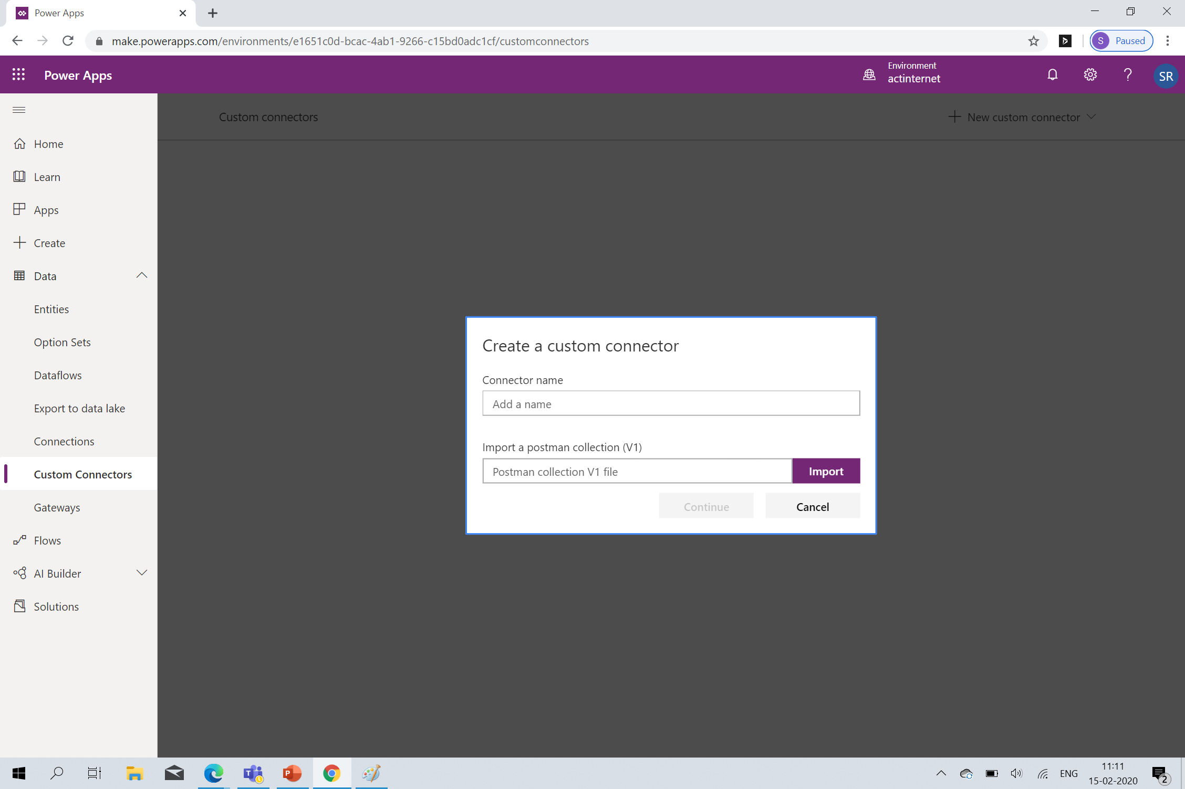
Demo

Slide 11
Testing the Connector

Slide 12
Publishing & Certifying the Connector
Why should you certify a connector?
Drive more usage Expand the reach of your API
What is Certification Criteria?

Slide 13
Opportunities for ISVs

Slide 14
FAQs
Can I build a connector without REST APIs?
What tools can I use to expose an API?
What authentication types are supported?
What are the limits for connectors and API requests?
Do you support Postman Collection V2?

Slide 15
Any Questions?

Slide 16
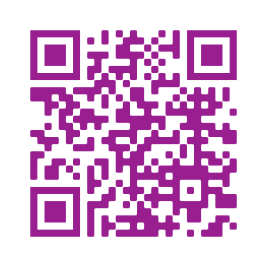
Please fill out the survey! & Win Swags!!
https://www.powerplatformbootcamp.com/survey

Slide 17
Thank You For Attending

